Slide 1
Universal Coupling
01/08/2016
Dr.S.Sundaram
Dean / Mechanical Engineering
Muthayammal Engineering College, Rasipuram

Slide 2
Couplings
A device that is used to connect two shafts together for the purpose of power transmission.
General types of couplings are:
Rigid: for aligned shafts
Flexible: for non-aligned shafts

Slide 3
Rigid Couplings
Coupling has no flexibility or resilience, and used for the shafts that are to be connected to be in good alignment, both laterally and angularity, in order to avoid excessive loads on the coupling, on the shafts, or on the shaft bearings.

Slide 4
Sleeve coupling
Hollow cylinder which is fitted over the ends of the two shafts to be connected and is then keyed there to by a sunk key.
The three links acting as a single rigid member.
Securing the joint made with the help pressure fits, screws and pins.
The coupling is simple in design and manufacture.
The disadvantages of the sleeve coupling are the difficulty in disassembly that is either the sleeve must be shifted along the shaft at least half its length or the shafts must be drawn apart to free the entire length of the coupling.
The necessity for highly accurate axial of the shafts since misalignment of shaft axes due to negligent assembly, or deformation under load, gives rise to forces that deflect the shafts.

Slide 5
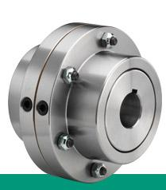
Sleeve Coupling

Slide 6
Clamp Coupling
Clamp coupling is a compression coupling
Coupling is made in two parts, that fit the shaft and are finished off around the periphery and on both ends. Its construction permits of its being readily assembled and removed which distinct advantage.
The two halves of the coupling are clamped tightly against the surface of the shaft ends by through bolts and the torsional moment is transmitted by friction.
In large couplings a key is incorporated between the shafts and coupling transmits the main torsional moment

Slide 7
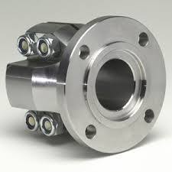
Clamp Coupling

Slide 8
Flange coupling
A rigid flange coupling consists of two cast iron flanges are mounted and keyed on the ends of each shaft and are drawn together by a series of bolts.
For more accurate connection, on the ends of the flange couplings machined the centering surfaces.
The bolts holding the flanges together are sometimes reduced in diameter so that they would readilybreak or shear off in the event of a damaging overload that to serve as a safety device.

Slide 9
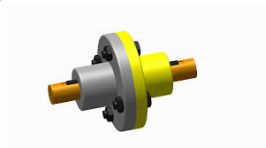
Flange Coupling

Slide 10
Flexible Couplings
Flexible couplings are designed to transmit torque smoothly while permitting some axial, radial, and angular misalignment.
The flexibility is such that when misalignment does occur, parts of the coupling move with little or no resistance. Thus, no significant axial or bending stresses are developed in the shaft.
Many types of flexible couplings are available commercially.
The degree of misalignment that can be accommodated by a coupling should be obtained from the catalog data.

Slide 11
Slip Coupling
A slip coupling is permit relative rotation, or slip, between the driving shaft and the driven shaft.
A slip coupling is a safety device that prevents damage to rotating parts because of overloading.
The slip begins if the load exceeds by 10 - 20 % the maximum load the shafts and other parts are designed.
There are many variations in form of this type of coupling.

Slide 12
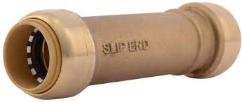
Slip Coupling

Slide 13
Universal Flexible Coupling
In cases where the angular or off set misalignment of the shaft reaches values which cannot be accommodated by flexible couplings, the Hooke's coupling or Universal Flexible coupling applied to good advantage.
The universal coupling is used for two shafts whose center lines form a large angle, as 50 to 150, or even 450 . The joint has no torsional flexibility and can accommodate any parallel misalignment, i.e., shafts must intersect.
Single universal joints have the disadvantage that the rotational speed of the output shaft is non uniform in relation to the input shaft.

Slide 14
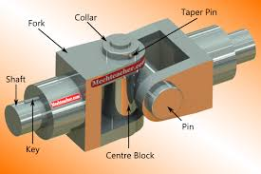
Universal Coupling

